Slide 1

AIR BNB IN Madrid
Done by: Hussain Alshaway

Slide 2

Data
Before Cleaning
After Cleaning
Columns: 79
Rows: around 26000
Columns:48
Rows: around 16000

Slide 3
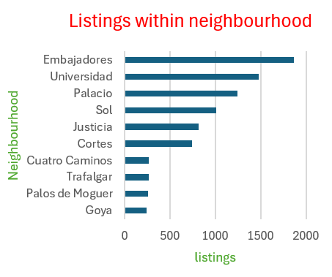
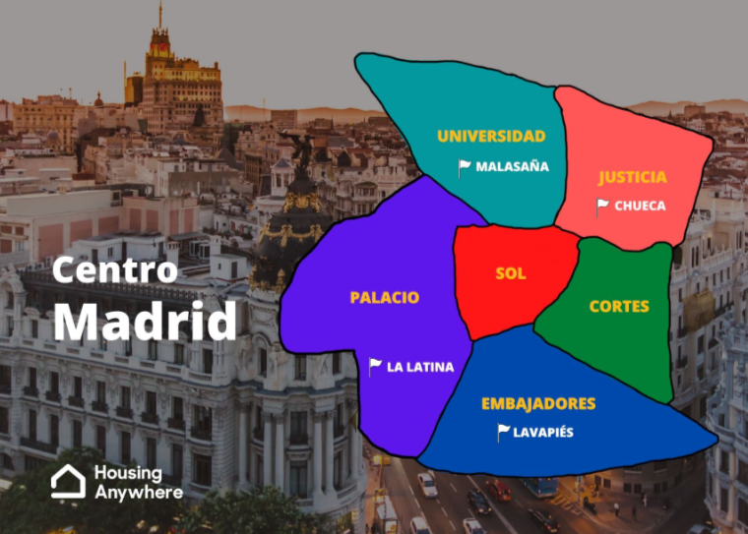
neighbourhoods with most listings

Slide 4
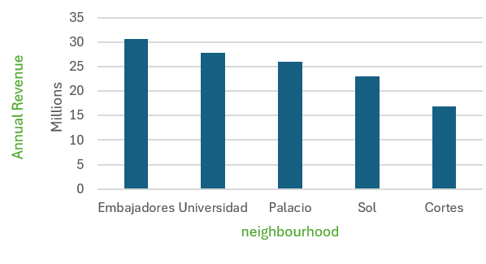
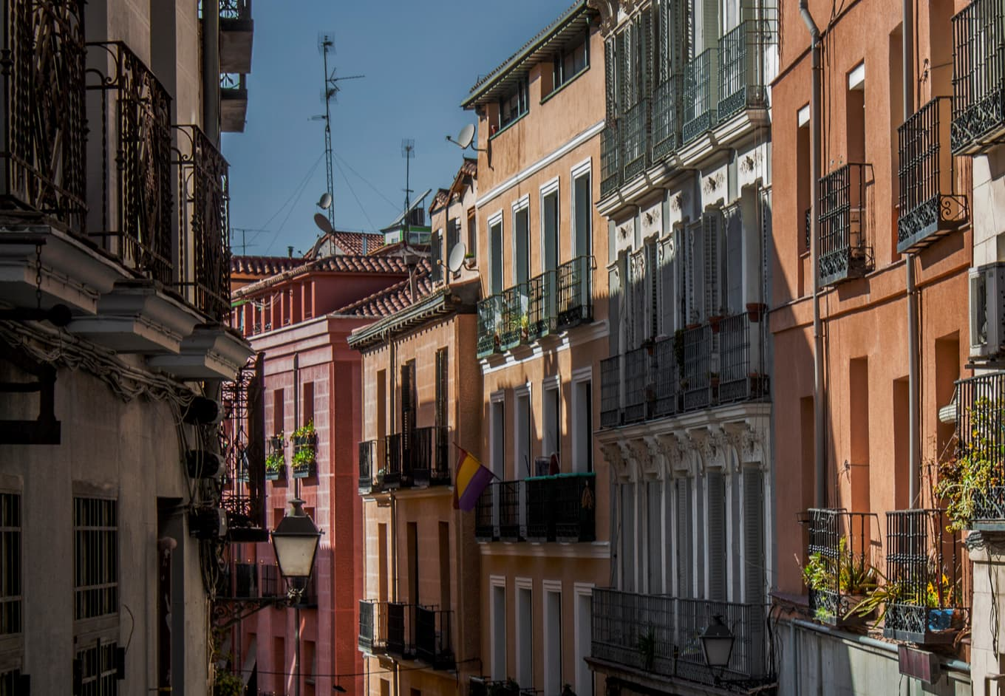
Neighbourhoods with top revenue

Slide 5
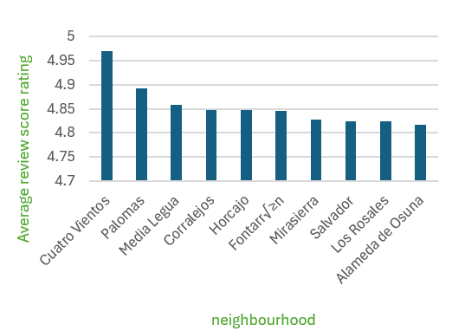
Average rating in neighbourhood

Slide 6
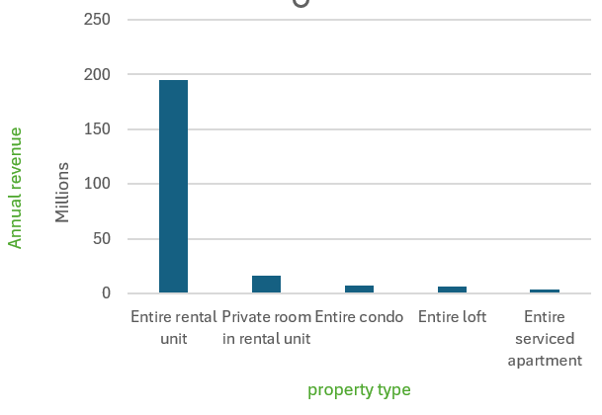

Which property type has highest revenue?

Slide 7
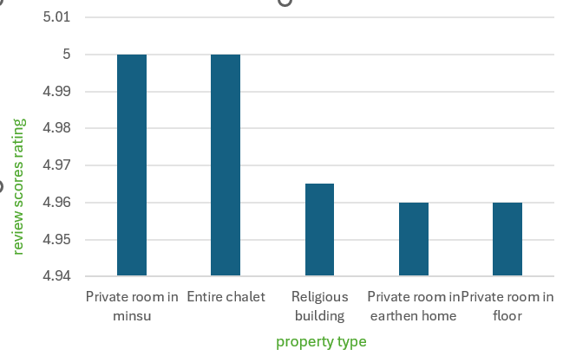
Which property type has highest rating?

Slide 8
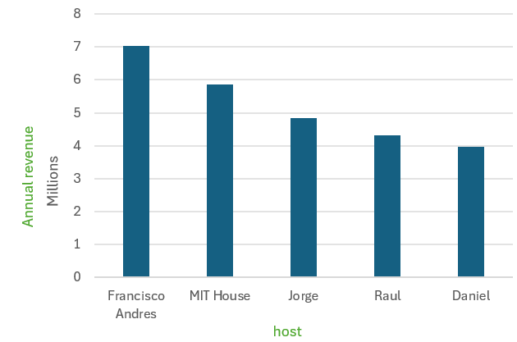
Which host is gaining the most?

Slide 9
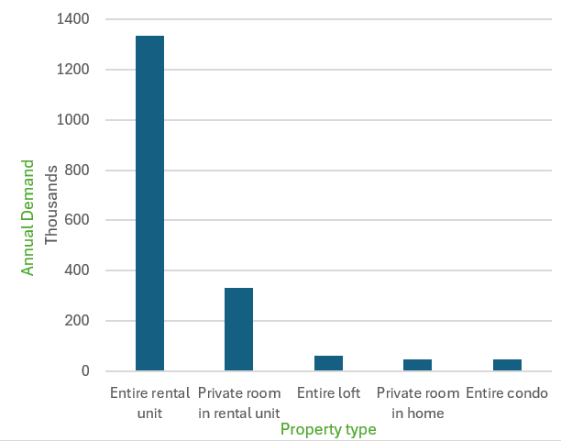
Property type that has highest demand

Slide 10
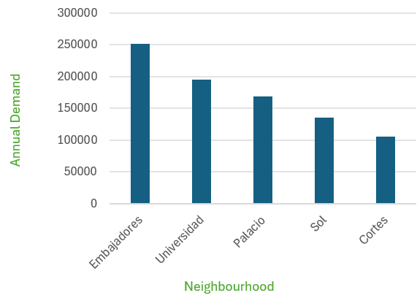
Neighbourhood that has highest demand

Slide 11
Recommendations:
1- Investing in Embajadores is highly recommended due to its highest annual revenue and highest demand
2- Property type of “Entire rental unit” is favored because it has highest annual revenue and highest demand

Slide 12

Thank you

